Slide 1
Rethinking Reproductive health including contraception programmes in the context of the ECHO results
23 July 2019, Mexico
Petrus Steyn and James Kiarie

Slide 2
Outline
ECHO Study key considerations
Integration of HIV prevention in SRHR services
Expand contraceptive options
Policy and programme considerations
Listening to ECHO

Slide 3
Key considerations
Access to preferred contraceptive methods should be maximized, while protecting women’s health
Women have the right to the latest and best information and to access a broad range of effective and acceptable methods
Current levels of contraceptive unmet need in many developing countries are not acceptable
Need to step up HIV prevention efforts, particularly in high-burden countries and for young women.

Slide 4
What Do We Mean by “Linkages” & “Integration”?
Linkages are bi-directional synergies in policy, systems and services between SRHR and HIV
Integration refers to joining operational programmes to ensure effective service delivery outcomes through various modalities (multi-tasked providers, referral, one-stop shop services under one roof, etc.)
Source: IAWG on SRH and HIV Linkages (2016) SRHR and HIV Linkages: Navigating the work in progress 2016
The IAWG on SRHR/HIV Linkages
For more information see www.srhhivlinkages.org

Slide 5
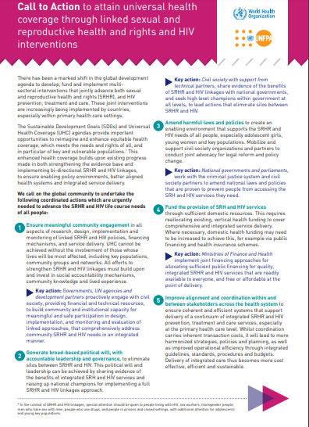
Call to Action to attain UHC through linked SRHR and HIV interventions
Meaningful community engagement
Eliminate silos between SRHR and HIV
Provide sufficient domestic resources
Inclusive primary health care services
Stronger multi-sectoral partnerships
Promote innovative approaches

Slide 6
SRHR and HIV Linkages Toolkit: http://toolkit.srhhivlinkages.org
A simple to use toolkit that guides users to the most recent, relevant and important SRHR and HIV linkages resources

Slide 7
Expanding contraceptive method mix
All three methods were well accepted and had high levels of safety and effectiveness
Countries should consider expanding contraceptive choices by introducing new contraceptive technologies, expanding access to existing methods, expanding the provider base and including self-care interventions.
Self-care interventions for family planning are included in the WHO consolidated guideline on self-care interventions for health: sexual and reproductive health and rights

Slide 8
Considerations for expanding Contraceptive Choice
Introducing new contraceptive technologies
Expanding access to exciting methods
Expand provider base

Slide 9
WHO Consolidated Guideline on Self-Care Interventions for Health - Sexual and Reproductive Health and Rights
2. Providing high-quality services for family planning, including infertility services
REC 10 (NEW): Self-administered injectable contraception should be made available as an additional approach to deliver injectable contraception for individuals of reproductive age.
REC 11 (NEW): Over-the-counter oral contraceptive pills (OCPs) should be made available without a prescription for individuals using OCPs.

Slide 10
Maximize the potential of expanding Contraceptive Choices
Ensure a robust supply chain
Improve provider training and counselling
Generate demand

Slide 11
Listening to the ECHO
Although nothing new, it is the time for integration and method mix expansion
Advocacy
Presence of task-teams
Emerging technologies
Comprehensive rights based approach
Self-care intervention may provide some opportunities
Explore implementation studies that promote FP and HIV prevention outcomes

